Slide 1
Chapter 1
Why Project Management?

Slide 2
Chapter 1 Learning Objectives
After completing this chapter, students will be able to:
Understand why project management is becoming such a powerful and popular practice in business.
Recognize the basic properties of projects, including their definition.
Understand why effective project management is such a challenge.
Differentiate between project management practices and more traditional, process-oriented business functions.
Recognize the key motivators that are pushing companies to adopt project management practices.

Slide 3
Chapter 1 Learning Objectives
After completing this chapter, students will be able to:
Understand and explain the project life cycle, its stages, and the activities that typically occur at each stage in the project.
Understand the concept of project “success,” including various definitions of success, as well as the alternative models of success.
Understand the purpose of project management maturity models and the process of benchmarking in organizations.
Identify the relevant maturity stages that organizations go through to become proficient in their use of project management techniques.

Slide 4
Introduction
Examples of projects
  Split the atom
  Tunnel under the English Channel
  Introduce Windows 7
  Plan next Olympic games in London
“Projects, rather than repetitive tasks, are now the basis for most value-added in business”
-Tom Peters

Slide 5
Process vs. Project Work
Process
Ongoing, day-to-day activities to produce goods and services
Use existing systems, properties, and capabilities
Typically repetitive
Project
Take place outside the normal, process-oriented world
Unique and separate from routine, process-driven work
Continually evolving
A project is a temporary endeavor undertaken to create a unique product or service.
PMBoK 2008

Slide 6
Additional Definitions
A project is a unique venture with a beginning and an end, conducted by people to meet established goals within parameters of cost, schedule, and quality. Buchanan & Boddy 92
Projects are goal-oriented, involve the coordinated undertaking of interrelated activities, are of finite duration, and are all, to a degree unique. Frame 95

Slide 7
Project Definitions Summarized
A project can be considered any series of activities and tasks that have:
Specific objectives to be completed within certain specifications,
Defined start and end dates,
Funding limits,
Human and nonhuman resources, and
Multifunctional focus.

Slide 8
Elements of Projects
Complex, one-time processes
Limited by budget, schedule, and resources
Developed to resolve a clear goal or set of goals
Customer-focused

Slide 9
General Project Characteristics
Ad-hoc endeavors with a clear life cycle
Building blocks in the design and execution of organizational strategies
Responsible for the newest and most improved products, services, and organizational processes
Provide a philosophy and strategy for the management of change

Slide 10
General Project Characteristics
Entail crossing functional and organization boundaries
Traditional management functions of planning, organizing, motivating, directing, and controlling apply
Principal outcomes are the satisfaction of customer requirements within technical, cost, and schedule objectives
Terminated upon successful completion of performance objectives

Slide 11
Process & Project Management (Table 1.1)
Process
Repeat process or product
Several objectives
Ongoing
People are homogeneous
Systems in place to integrate efforts
Performance, cost, & time known
Part of the line organization
Bastions of established practice
Supports status quo
Project
New process or product
One objective
One shot – limited life
More heterogeneous
Systems must be created to integrate efforts
Performance, cost & time less certain
Outside of line organization
Violates established practice
Upsets status quo

Slide 12
Project Success Rates
Software & hardware projects fail at a 65% rate,
Over half of all IT projects become runaways,
Only 30% of technology-based projects and programs are a success.
Only 2.5% of global businesses achieve 100% project success and over 50% of global business projects fail,
Average success of business-critical application development projects is 32%, and
Approximately 42% of the 1,200 Iraq reconstruction projects were eventually terminated due to mismanagement or shoddy construction

Slide 13
Why are Projects Important?
Shortened product life cycles
Narrow product launch windows
Increasingly complex and technical products
Emergence of global markets
Economic period marked by low inflation

Slide 14
Project Life Cycles
Man Hours
Conceptualization
Planning
Execution
Termination
Fig 1.3 Project Life Cycle Stages

Slide 15
Project Life Cycles
Conceptualization - the development of the initial goal and technical specifications.
Planning – all detailed specifications, schedules, schematics, and plans are developed
Execution – the actual “work” of the project is performed
Termination – project is transferred to the customer, resources reassigned, project is closed out.

Slide 16
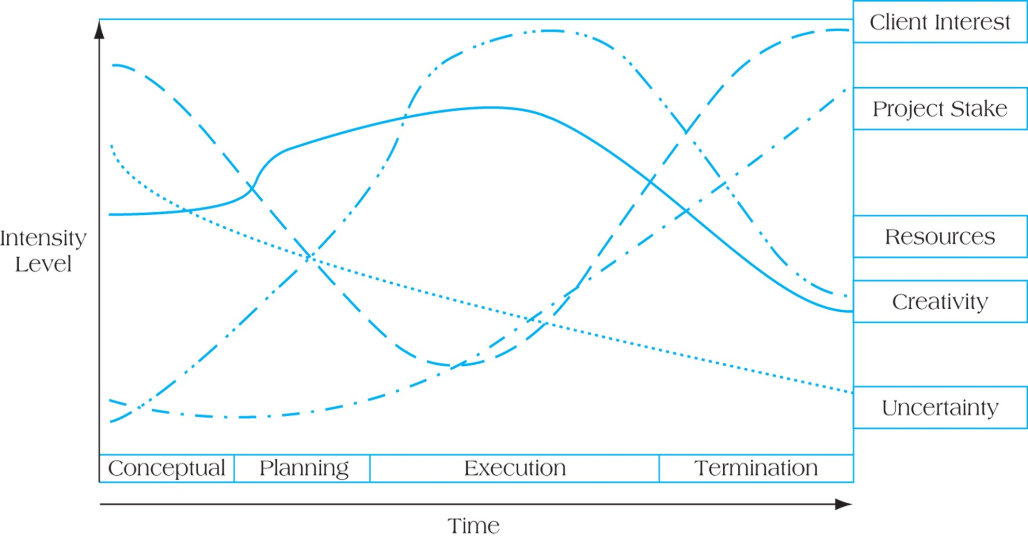
Project Life Cycles and Their Effects
FIGURE 1.4 Project Life Cycles and Their Effects

Slide 17
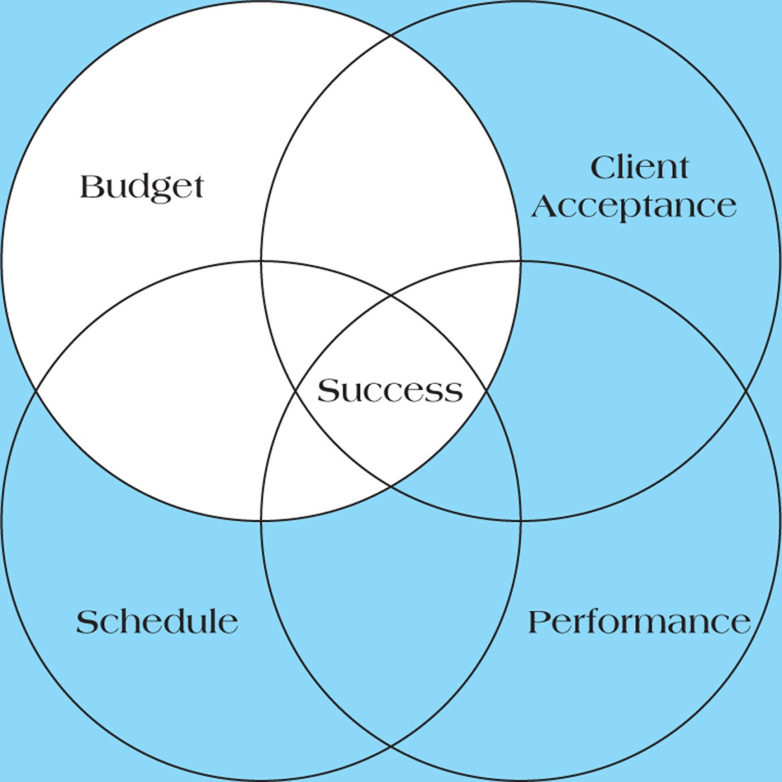
Quadruple Constraint of Project Success
Figure 1-6

Slide 18
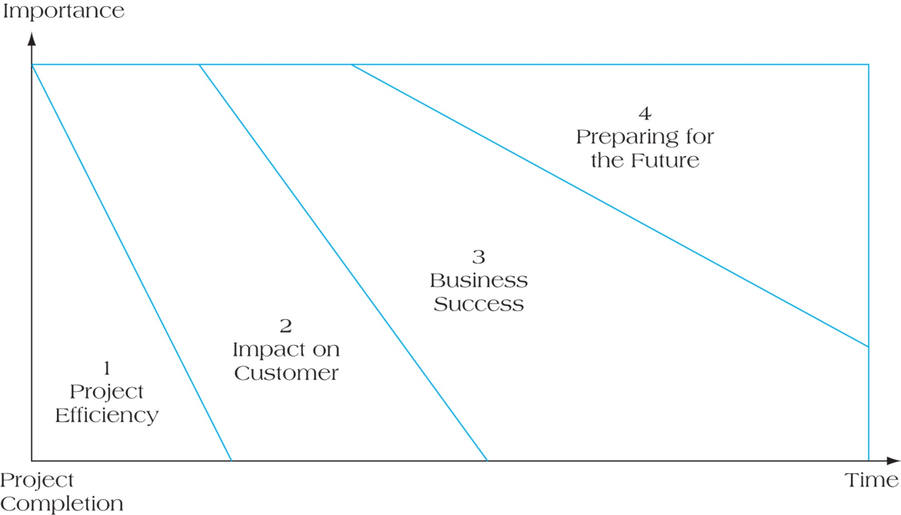
Four Dimensions of Project Success
FIGURE 1.7

Slide 19
Six Criteria for IT Project Success
System quality
Information quality
Use
User satisfaction
Individual impact
Organizational impact

Slide 20
Understanding Success Criteria
Table 1.2

Slide 21
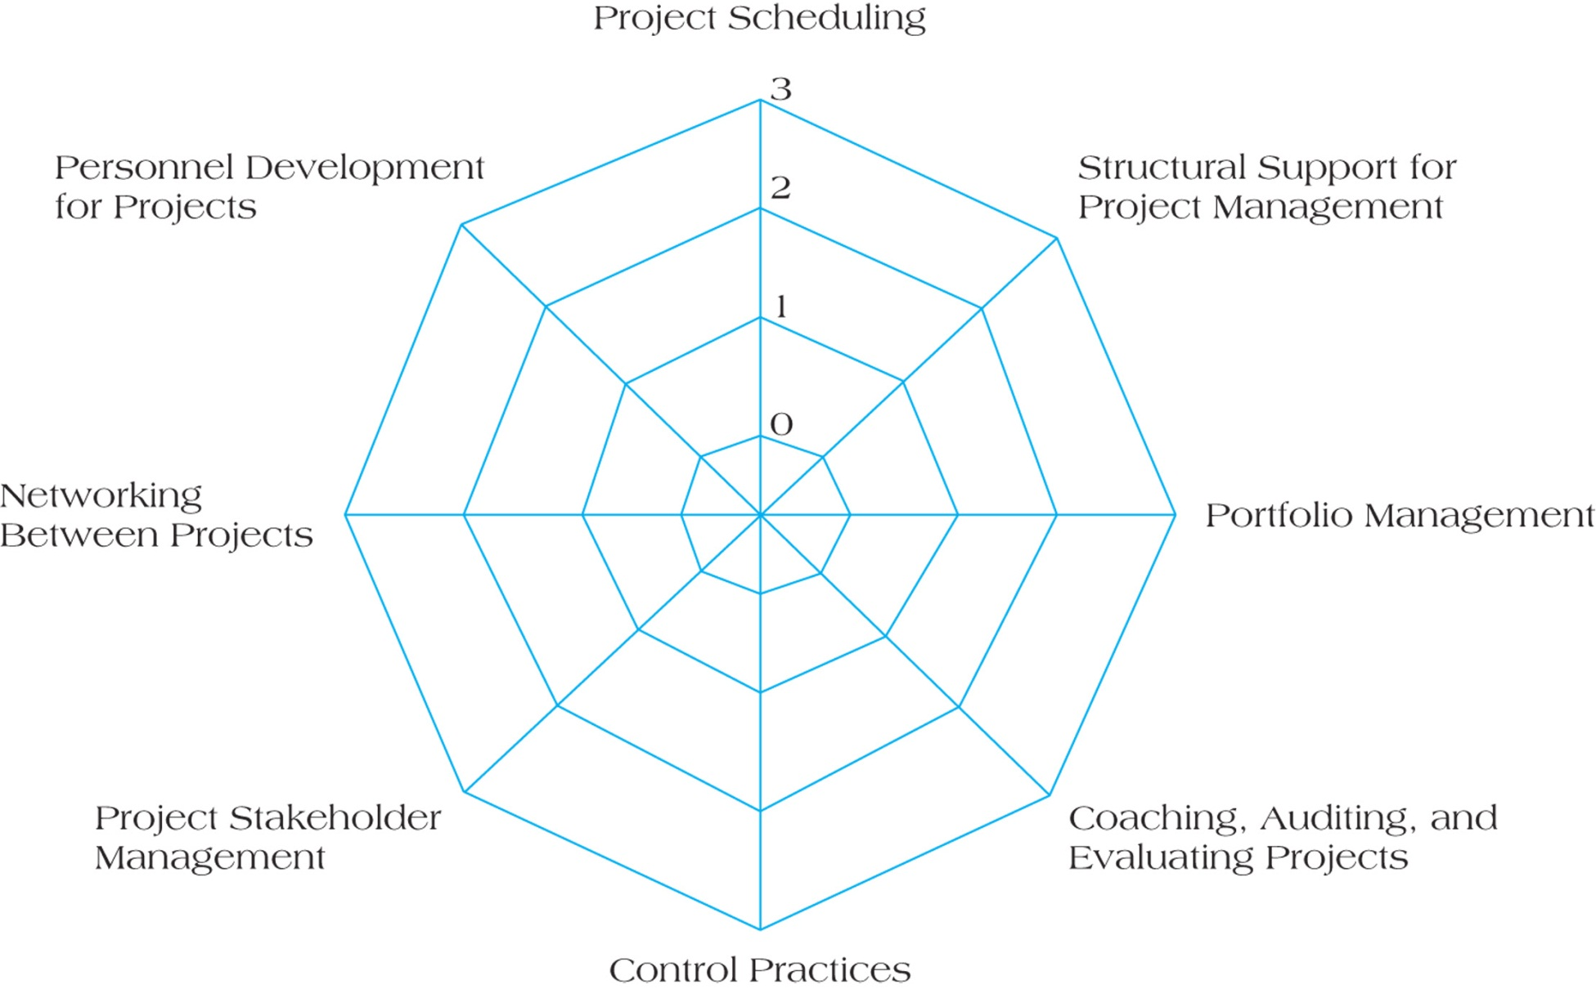
Spider Web Diagram (Figure 1.8)

Slide 22
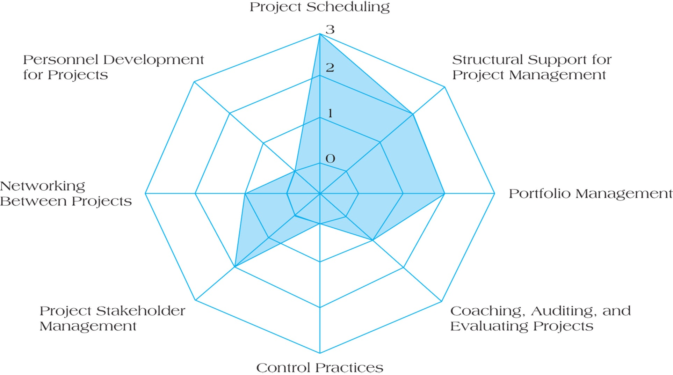
Spider Web Diagram with Embedded Organizational Evaluation
Figure 1-9

Slide 23
Developing Project Management Maturity
Project Management Maturity (PMM) Models
  Center for Business Practices
  Kerzner’s Project Management Maturity Model
  ESI International’s Project Framework
  SEI’s Capability Maturity Model Integration

Slide 24
Center for Business Practices PMM
Level 1: Initial Phase
Level 2: Structure, Process, and Standards
Level 3: Institutionalized Project Management
Level 4: Managed
Level 5: Optimizing

Slide 25
Kerzner’s PMM Model
Level 1: Common Language
Level 2: Common Processes
Level 3: Singular Methodology
Level 4: Benchmarking
Level 5: Continuous Improvement

Slide 26
ESI International’s Project Framework
Level 1: Ad Hoc
Level 2: Consistent
Level 3: Integrated
Level 4: Comprehensive
Level 5: Optimizing

Slide 27
SEI’s Capability Maturity Model Integration
Level 1: Initial
Level 2: Managed
Level 3: Defined
Level 4: Quantitative Management
Level 5: Optimizing

Slide 28
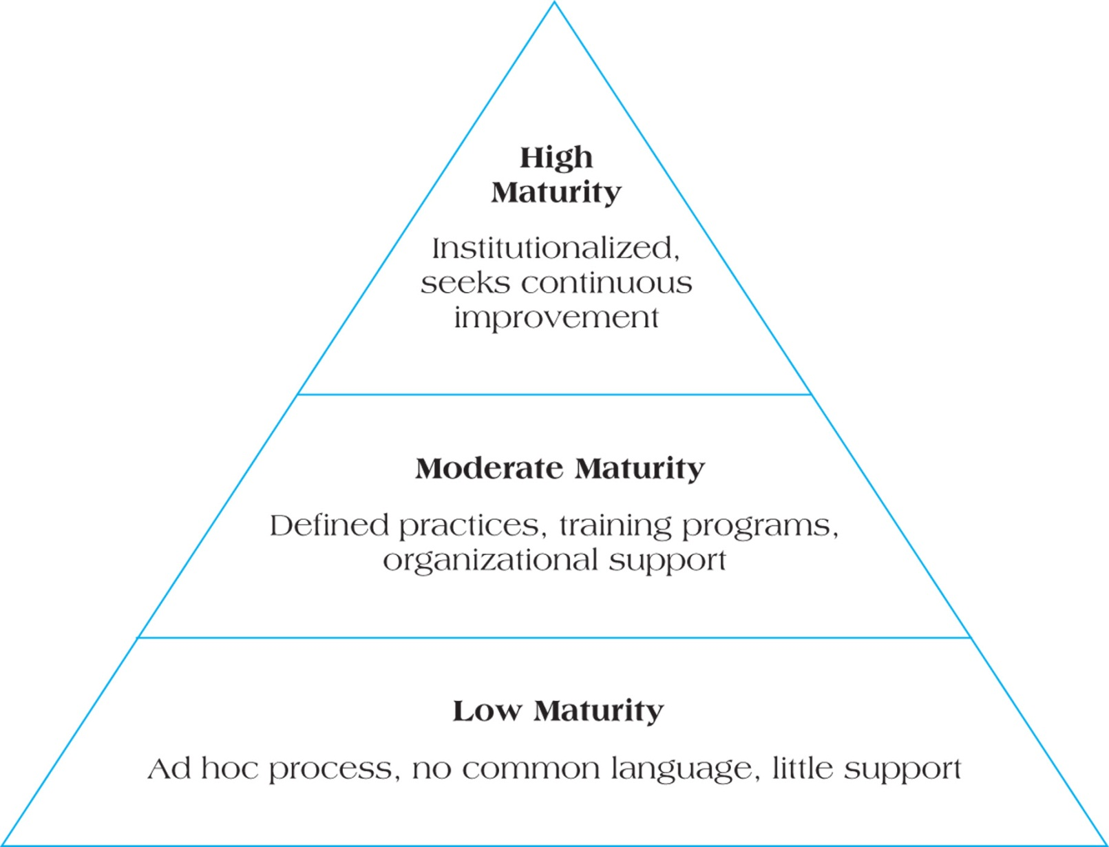
Project Management Maturity Generic Model
FIGURE 1.10

Slide 29
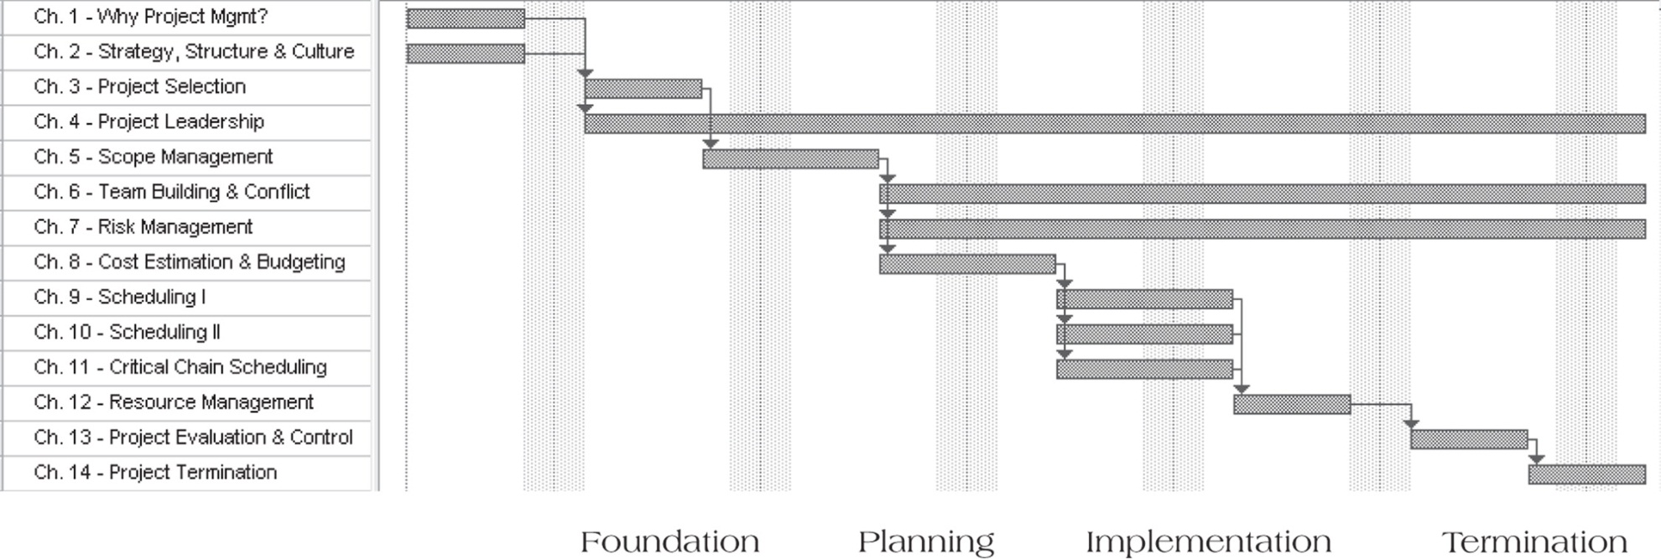
Project Elements and Text Organization
FIGURE 1.11 Organization of Text

Slide 30
Project Manager Responsibilities
Selecting a team
Developing project objectives and a plan for execution
Performing risk management activities
Cost estimating and budgeting
Scheduling
Managing resources

Slide 31
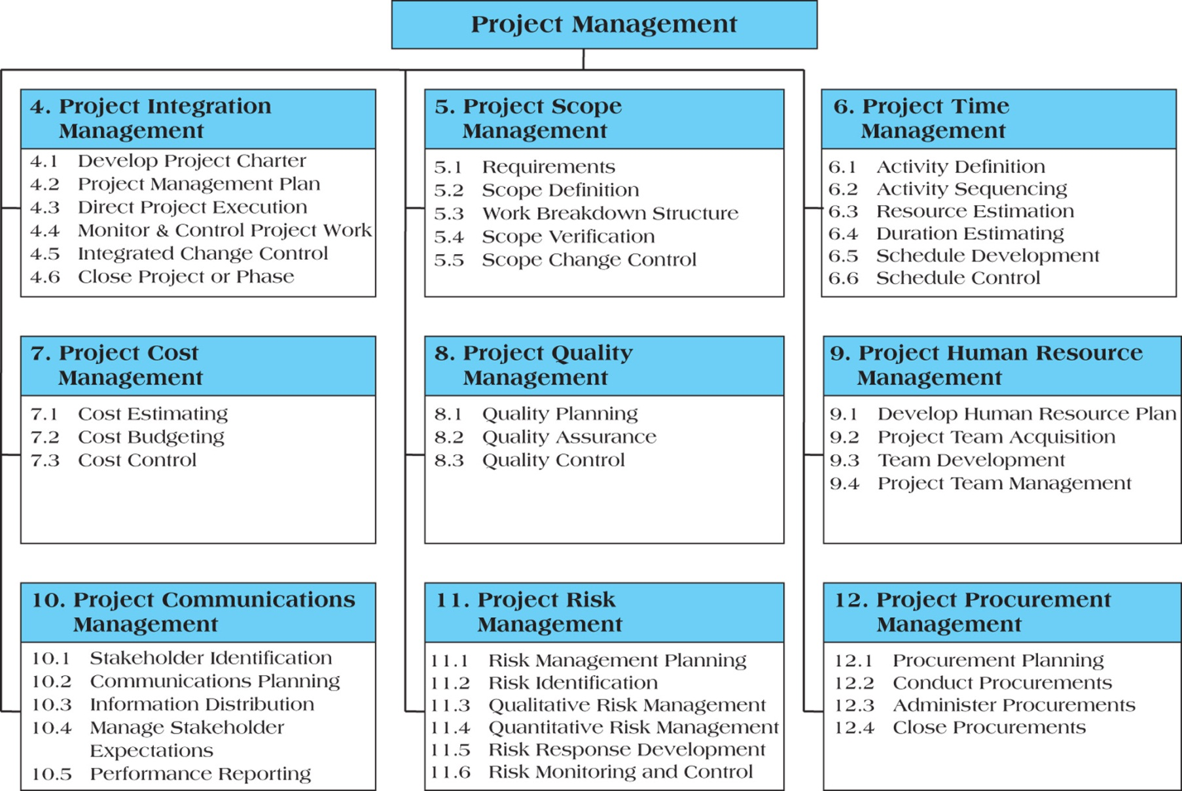
Overview of the Project Management Institute’s PMBoK Knowledge Areas
FIGURE 1.12

Slide 32
Summary
Understand why project management is becoming such a powerful and popular practice in business today.
Recognize the basic properties of projects, including their definition.
Understand why effective project management is such a challenge.
Differentiate between project management practices and more traditional, process-oriented business functions.
Recognize the key motivators that are pushing companies to adopt project management practices.

Slide 33
Summary
Understand and explain the project life cycles, its stages, and the activities that typically occur at each stage in the project.
Understand the concept of project “success,” including various definitions of success, such as the “triple constraint,” as well as alternative models of success.
Understand the purpose of project management maturity models and the process of benchmarking in organizations.
Identify the relevant maturity stages that organizations go through to become proficient in their use of project management techniques.

Slide 34


